Slide 1
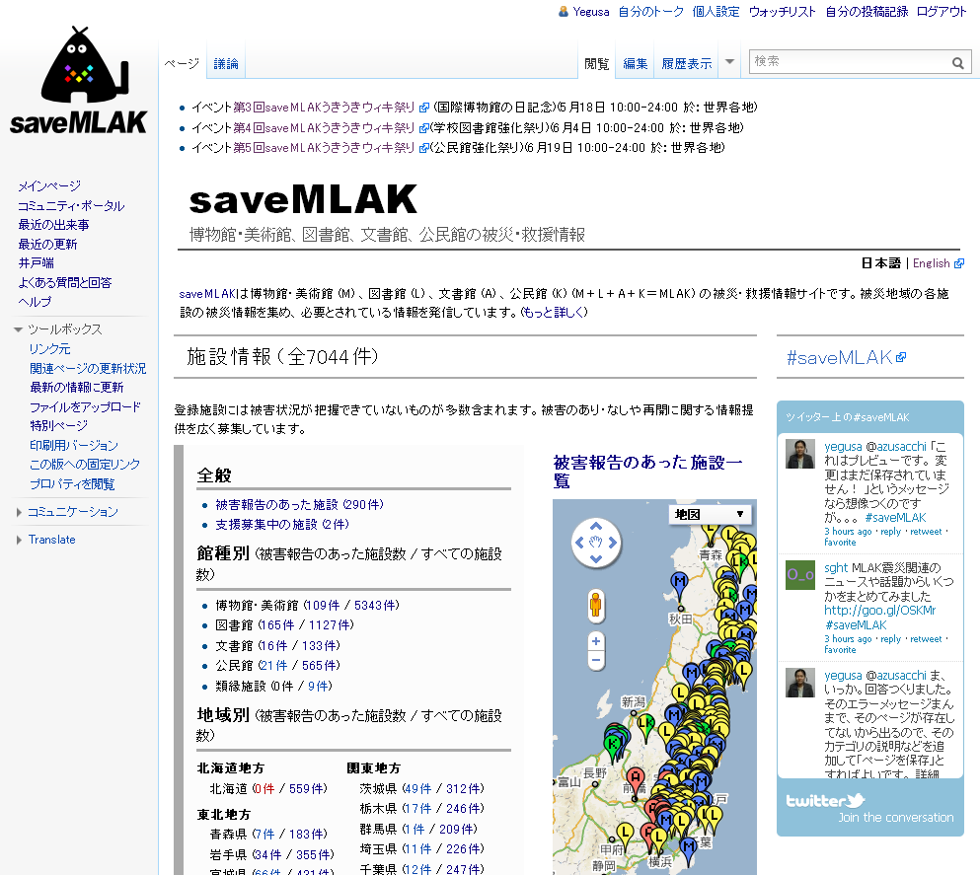
Information on the aftermath and relief operations for the Museums, Libraries, Archives and Kominkans*
(MLAK) affected by the Great East Japan Earthquake
*Kominkan=Community Center
(saveMLAK project; since 11 April 2011)
Following the 2011 Tōhoku earthquake and tsunami (the Great East Japan Earthquake), a group of volunteers (staff members of MLAK venues and other supporters) created a website to support the affected community service facilities.
saveMLAK (http://savemlak.jp/) is gathering and summarizing information on the damage to the staff and facilities in the disaster area and requests for assistance from the victims. It also provides advice and guidance to the affected museums, libraries, archives and community centers about what they can do and what they need.
- saveMLAK website -
saveMLAK; a website built to gather and share current condition and support needs of the MLAK facilities* in the area stricken by the 2011 Tohoku earthquake and tsunami (the Great East Japan Earthquake), in order to restore the functions of those facilities as Communication, Learning and Information hubs
Web address: http://savemlak.jp/
Twitter account: @saveMLAK
Twitter hash tag: #saveMLAK
*including art galleries, planetarium, zoo, aquarium, botanical gardens, monumental buildings etc. and other related community service facilities
- saveMLAK Project -
ML volunteer members: 299 (as of June 31, 2012)
saveMLAK website is managed and operated by a group of volunteers (staff members of Museums, Libraries, Archives, Kominkans and other supporters) called “saveMLAK Project”
Symbol : MLAK-kun (Mr.MLAK)
saveMLAK Timeline
11 March 2011 The Great East Japan Earthquake and tsunami
12 March “Save Library” and “save Museum” started individually
13 March “Save Archives” started
16 March MLA first conference call meeting. “Save Kominkan” started
04 April The first Meet up – 4 separate projects joined into one “saveMLAK”
11 April “saveMLAK” project was officially launched.
19 April The second saveMLAK Meet Up
23 April Emergency Discussion Meeting “The Great East Japan Earthquake and MLAK – Things we can do now”
@Gakushuin University. Approx 500 attendants (400 at the venue, over 100 on internet live).
Introduced on NHK news program “被災文化施設の支援で議論 (Discussion was held on rescuing community service facilities affected by the disaster)” http://nhk.jp/N3vL6VWs (in jpn)
24 April The 1st Uki-uki Wiki Matsuri; saveMLAK website editorial meeting using Wiki system - Some
volunteers gathered at venues set up across nationwide, some worked at home and received
technical instructions online
saveMLAK PR team： Mr.Okamoto, Ms.Yamamura and Ms.Kitaoka
E-mail：pr@savemlak.jp TEL：+81-70-5467-7032 (Okamoto)
c/o Academic Resource Guide, Inc. Sakura works[Kan’nai], Taisei building 2F, 3-61 Aioi-cho Naka-ku, Yokohama, Kanagawa, Japan
Updated on January 31, 2013

